Slide 1
SCHOOL OF EDUCATION
Abyasa Pro Mentor Portal – User guide
WWW.YORKSJ.AC.UK

Slide 2
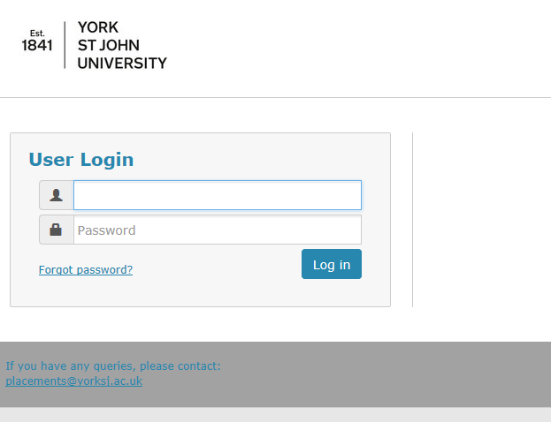
How to access the portal
You will receive an e-mail with the link to the portal and your login details. Enter these details on the Login Screen.
The link is https://placements.yorksj.ac.uk/pro/
www.yorksj.ac.uk

Slide 3
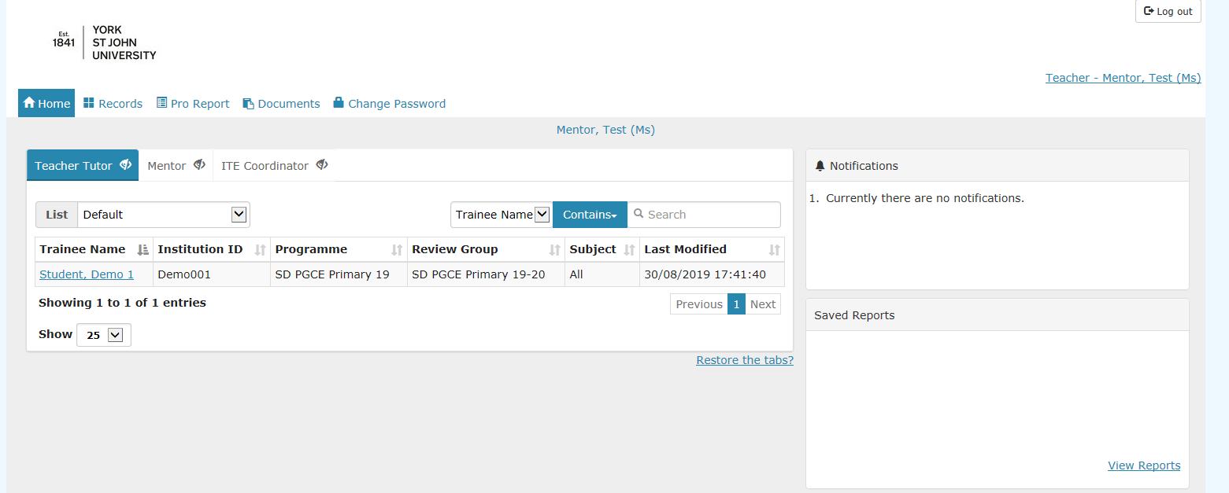
How to access the portal
When you have logged in you will be taken to the Welcome Page which shows the student teacher(s) you are mentoring. These will be listed under the ‘Teacher Tutor’ tab. You can hide the other tabs by clicking on the ‘eye’ icon if you wish.
If any of this information is incorrect please let us know at placements@yorksj.ac.uk
www.yorksj.ac.uk

Slide 4
How to change your password
Click on the ‘Change Password’ tab at the top of the page.
www.yorksj.ac.uk

Slide 5
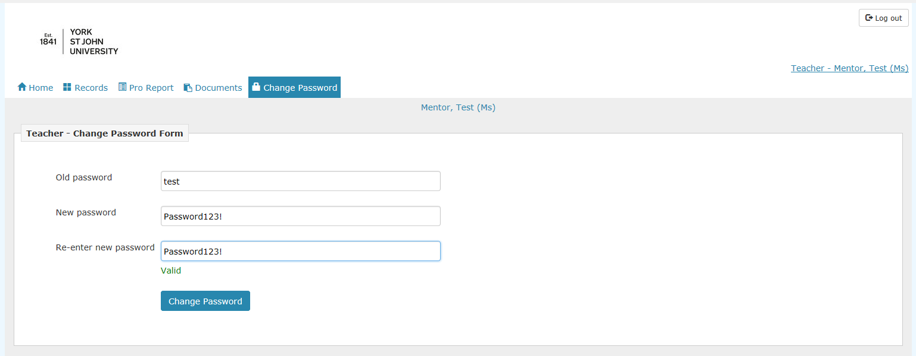
How to change your password
Type in your current password and then your new password twice.
Then click ‘Change Password’.
www.yorksj.ac.uk

Slide 6
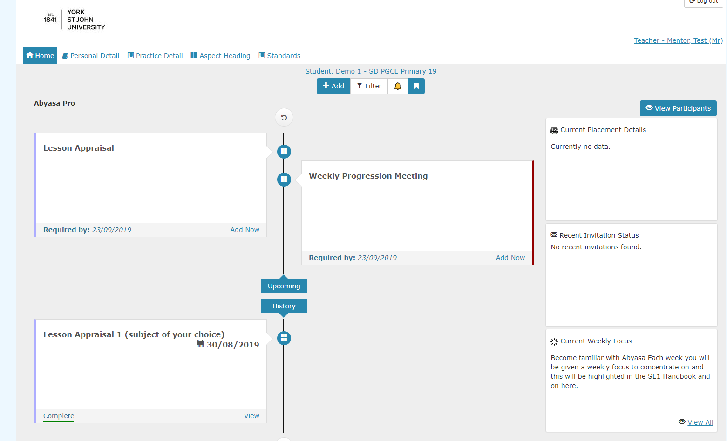
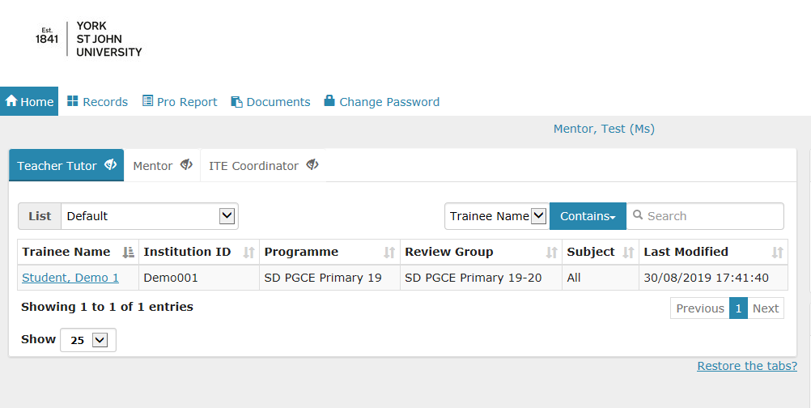
How to view and update reports
1. Start by clicking on the student you wish to add or edit reports for.
2. You will see the student’s timeline. If you scroll down you will see previous reports which have been submitted or where the deadline has passed. If you scroll up you will see upcoming reports.
www.yorksj.ac.uk

Slide 7
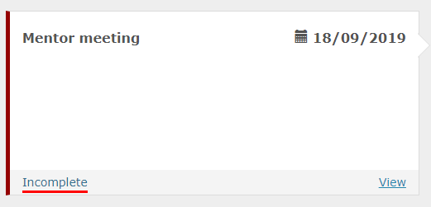
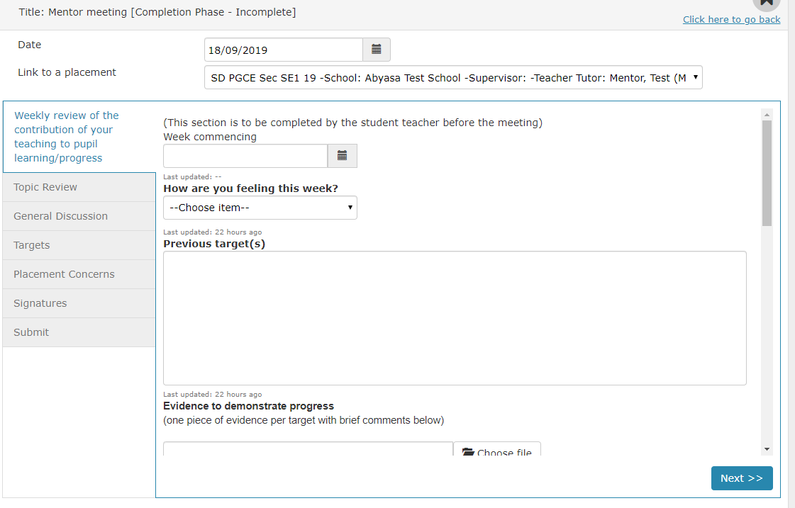
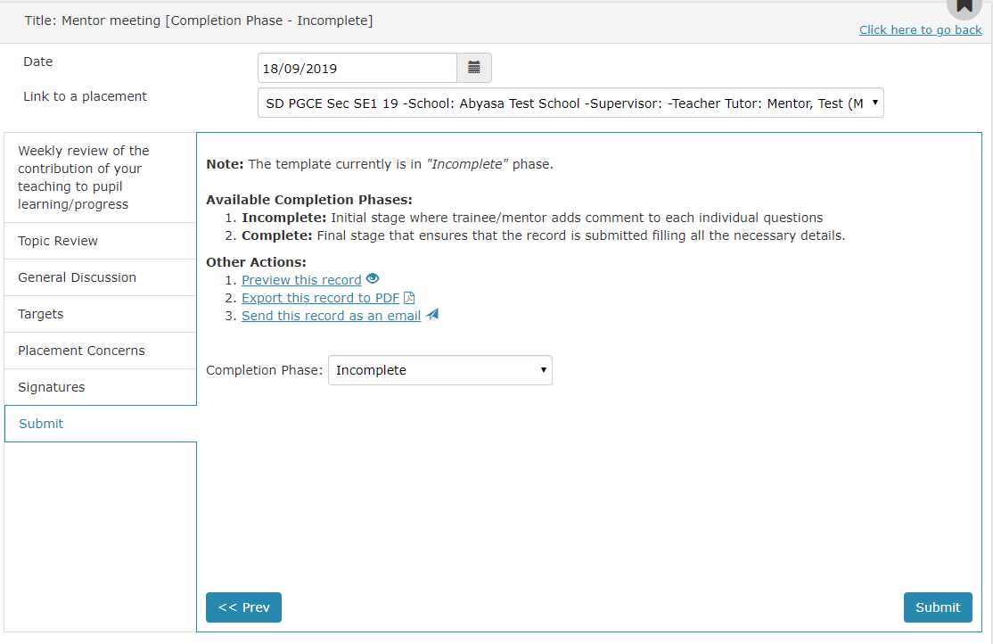
How to view and update reports
Remember, once you change the completion phase to ‘Complete’ it is no longer editable. Submit the report as ‘Incomplete’ if you still need to make amendments.
3. If you wish to edit a previous report select ‘View’ on that report.
4. The report will then appear and you can begin editing and follow the report to the end by clicking ‘Next’ and then ‘Submit’.
www.yorksj.ac.uk

Slide 8
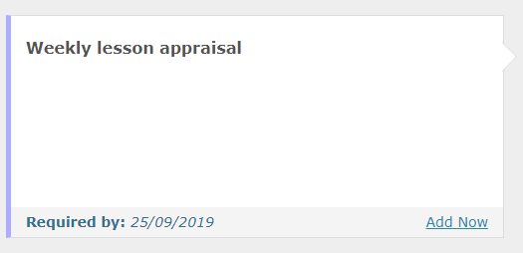
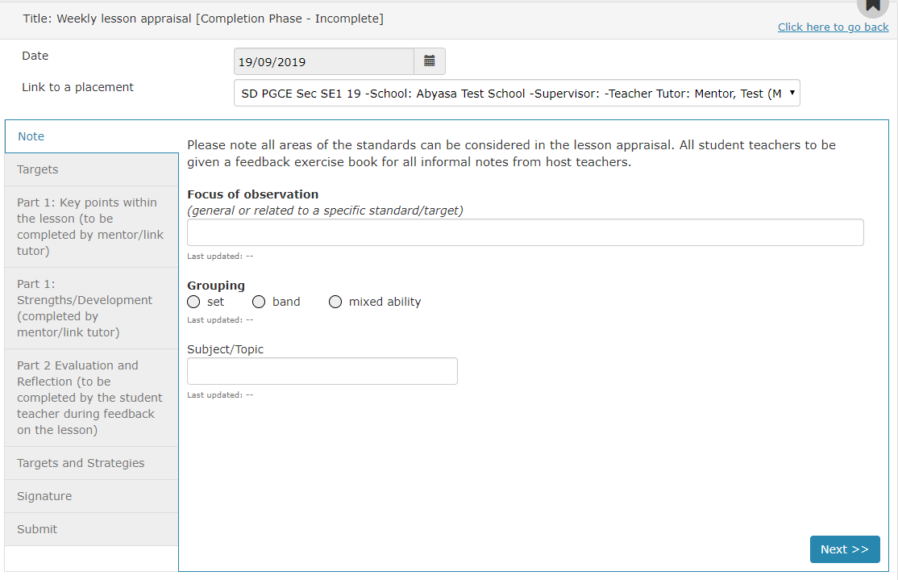
How to view and update reports
5. If you wish to submit an upcoming report click ‘Add Now’ on the report you want to add.
6. The date will be pre-populated. On the ‘Link to a placement’ drop down menu choose the correct placement which relates to this report. This will then take you to a screen where you can complete the report by filling in the boxes and clicking ‘Next’ and then ‘Submit’.
www.yorksj.ac.uk

Slide 9
Important documents and dates
What | When | Who
Weekly Mentor Progression Dialogue | Weekly 1 hr meeting. First meeting w/c 23 Sept 2019 | Student teacher - Pre-meeting sections and notes during the meeting Mentor – check notes and agree
Weekly Lesson Appraisal | One weekly formal appraisal. First appraisal completed w/c 4th November 2019 | Student teacher – To complete focus and target sections as indicated Mentor – Key points, strengths and targets to be completed by the mentor unless a host teacher has been trained by the partnership. Student teacher - Evaluation to be completed by the student teacher following the dialogue.
Interim Report | 11th November 2019 | Mentor
Final Report | 16th December 2019 | Mentor
Interim Report | 6th March 2020 | Mentor
Interim Report | 3rd April 2020 | Mentor
Final Report | 12th June 2020 | Mentor
www.yorksj.ac.uk

