Slide 1
SCHOOL OF EDUCATION
Abyasa Pro Placement Portal –
Link Tutor User guide
WWW.YORKSJ.AC.UK

Slide 2
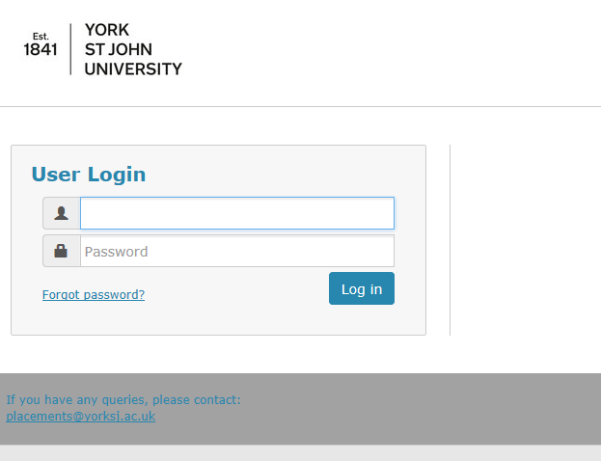
How to access the portal
You will receive an e-mail with the link to the portal and your login details. Enter these details on the Login Screen.
The link is https://placements.yorksj.ac.uk/pro/
www.yorksj.ac.uk

Slide 3
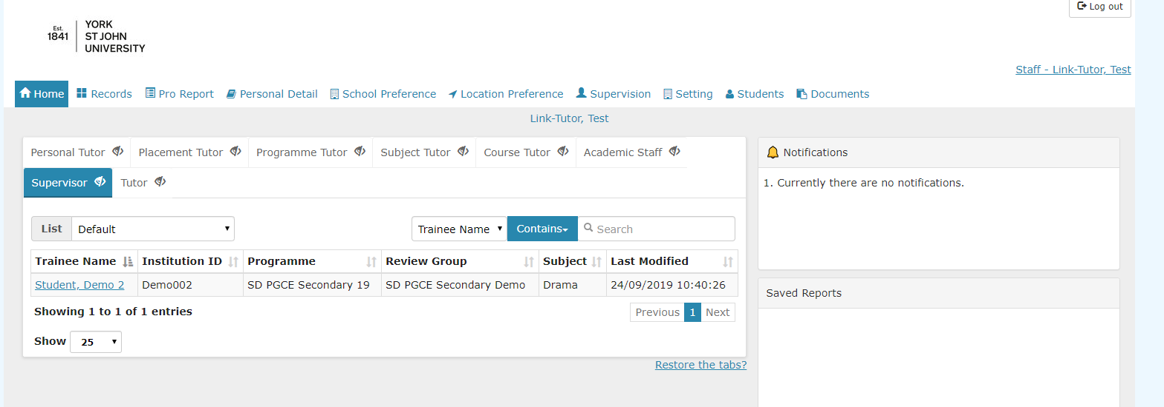
How to access the portal
When you have logged in you will be taken to the Home Page which shows the student teacher(s) you are supervising. These will be listed if you click on the ‘Supervisor’ tab. You can hide the other tabs by clicking on the ‘eye’ icon if you wish as they will be blank unless you hold other roles.
If any of this information is incorrect please let us know at placements@yorksj.ac.uk
www.yorksj.ac.uk

Slide 4
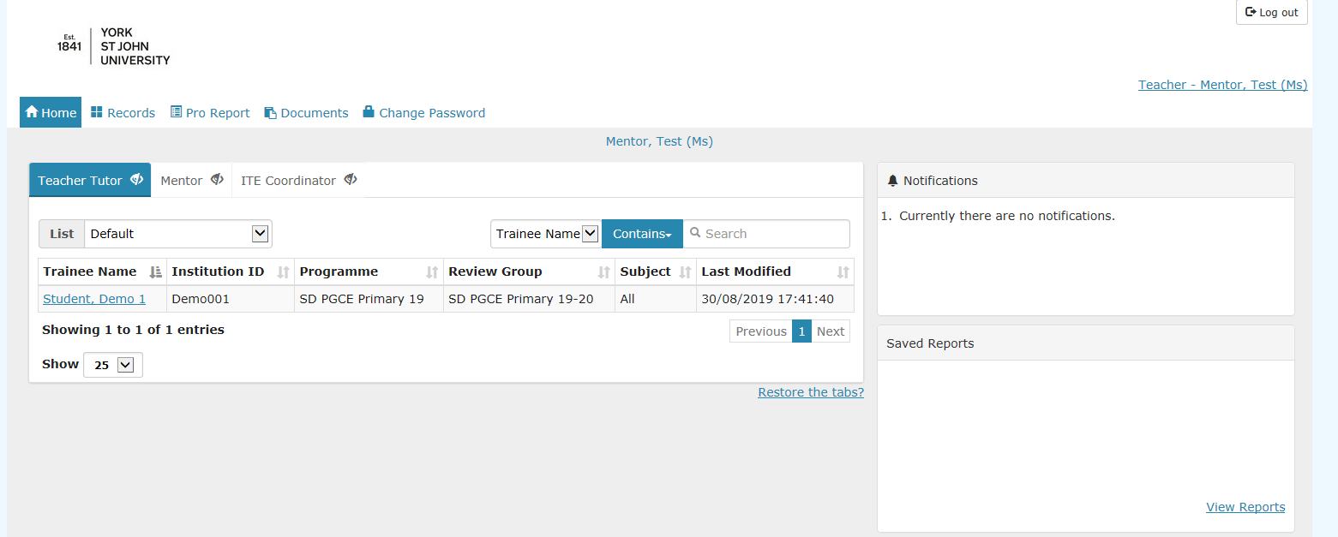
How to change your password
Click on the ‘Change Password’ tab at the top of the page.
www.yorksj.ac.uk

Slide 5
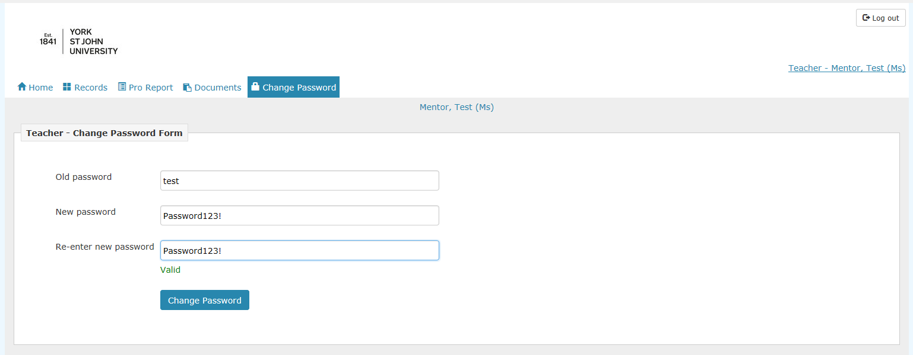
How to change your password
Type in your current password and then your new password twice.
Then click ‘Change Password’.
www.yorksj.ac.uk

Slide 6
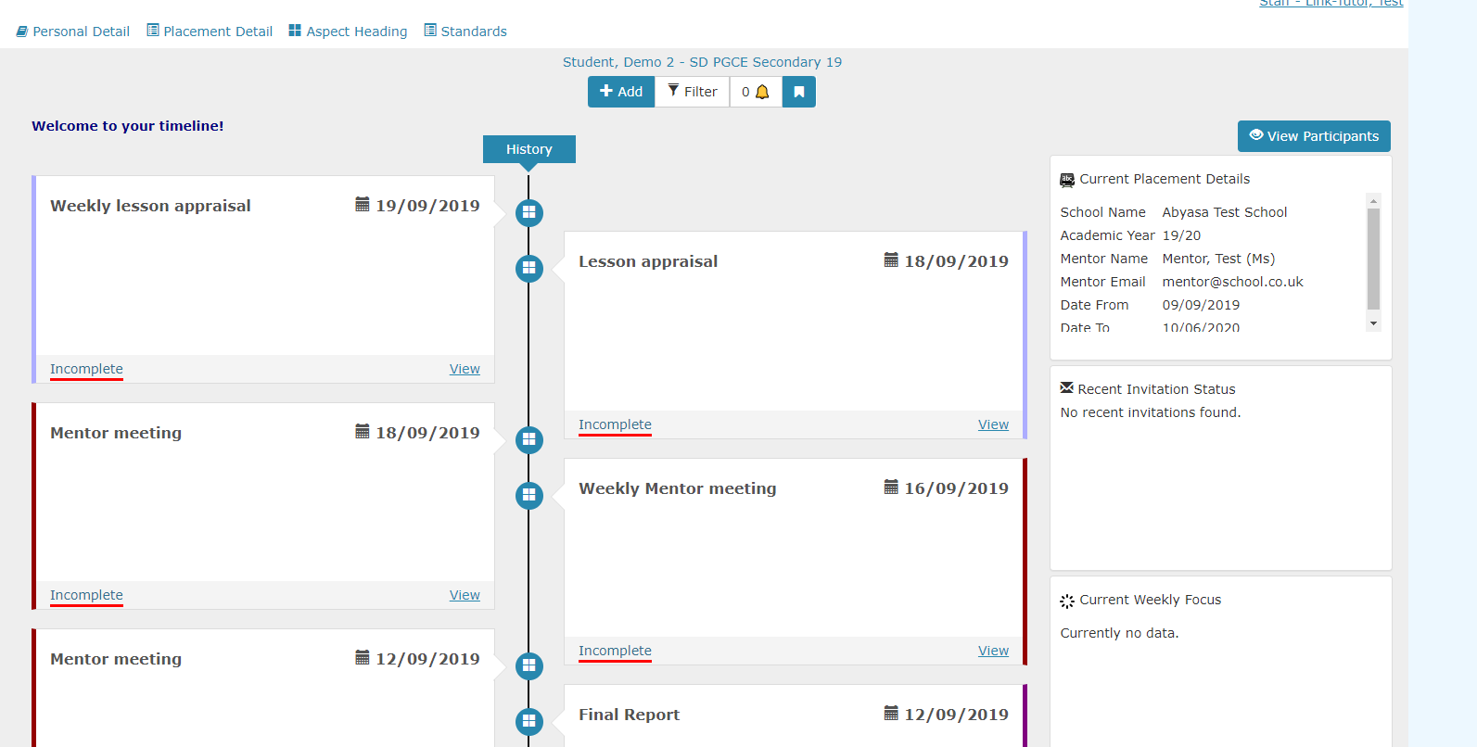
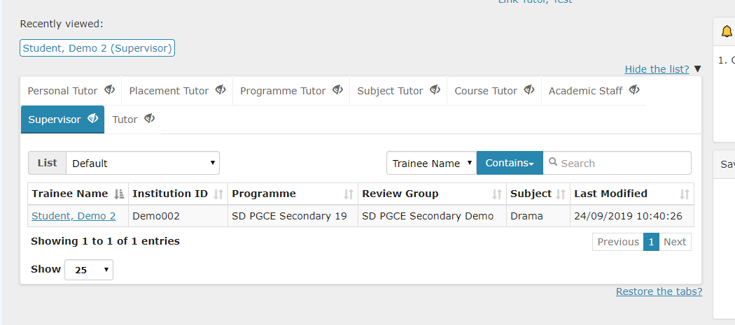
How to view reports by student
1. Start by clicking on the student whose reports you wish to view.
2. You will see the student’s timeline. If you scroll down you will see previous reports which have been submitted or where the deadline has passed. If you scroll up you will see upcoming reports.
www.yorksj.ac.uk

Slide 7
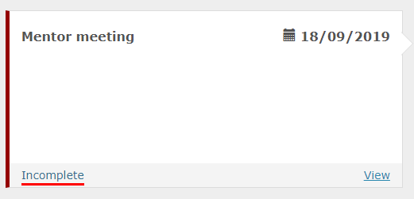
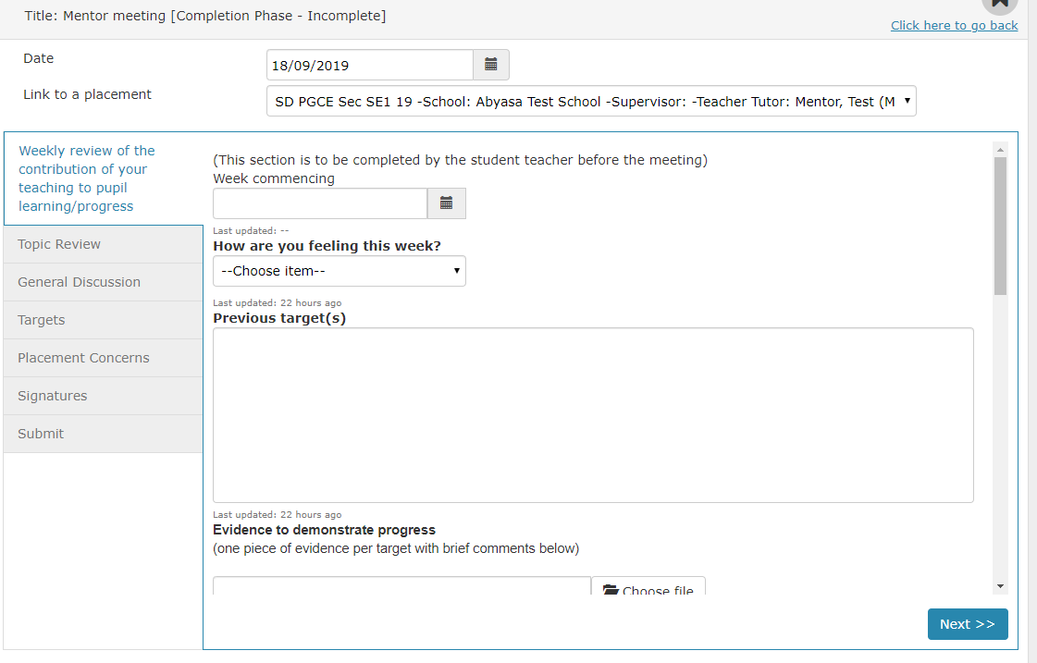
How to view reports by student
3. If you wish to view a report select ‘View’ on that report.
4. The report will then appear and you can view the report and follow it through to the end by clicking ‘Next’.
www.yorksj.ac.uk

Slide 8
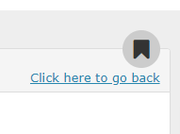
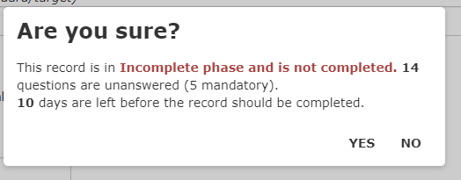
How to view reports by student
5. Press ‘Click here to go back’ to return to your home page. Ignore any warning that the form is incomplete and press ‘Yes’.
6. This will take you back to the student’s timeline. To return to the home page click on your name in the top right hand corner. You can press on your name at any time to return you to the home page.
www.yorksj.ac.uk

Slide 9
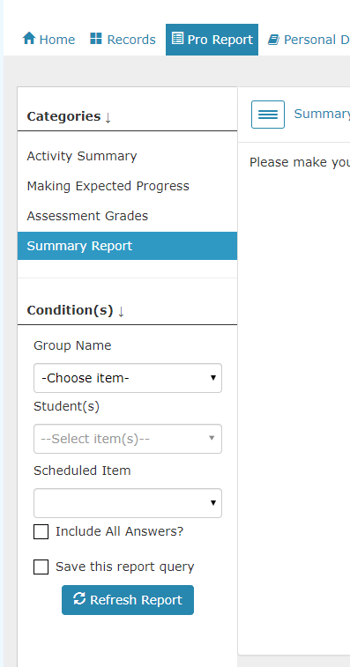
How to view a summary of reports
1. If you wish to view a list of the reports available for all of your students click on the ‘Pro Report’ tab.
2. Click on ‘Summary Report’ and then choose the relevant ‘Group Name’ and then the relevant ‘Scheduled item’ in the drop down boxes.
www.yorksj.ac.uk

Slide 10
How to view a summary of reports
3. Click on ‘Refresh Report’ and you will then see a list of the students and reports.
4. If a report has been added the ‘Action Type’ will show the View button. Click on this to view the report. If a report has not been added the ‘Action Type’ will show ‘Not Allowed’. You can sort the list by any of the column headings by clicking on the arrows.
www.yorksj.ac.uk

Slide 11
How to add a visit record
1. Click on the ‘Supervision’ tab and choose the relevant placement from the dropdown box. A list of your students will appear.
2. Click on the name of the student for whom you wish to add a visit record.
www.yorksj.ac.uk

Slide 12
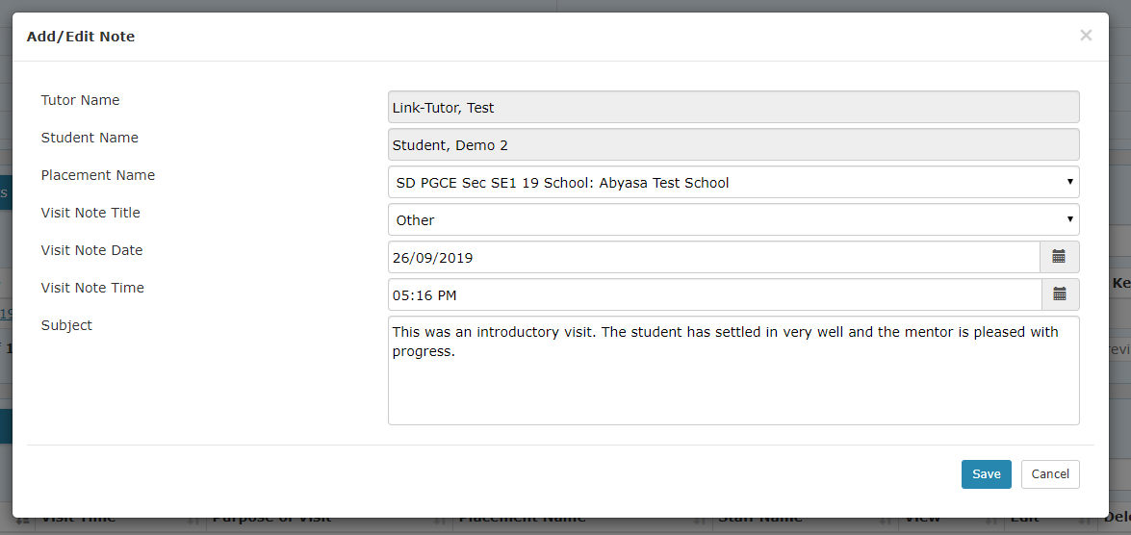
How to add a visit record
3. Scroll down to the bottom of their screen to where it says ‘Student Visit Notes’ and click on ‘Add New’.
4. The Tutor Name and Student Name will populate automatically. Make sure you choose the right options in the drop down boxes for ‘Placement Name’ and ‘Visit Note Title’ and enter the date and time. Lastly write a brief summary of what happened during your visit in the ‘Subject’ box and then remember to press ‘Save’.
www.yorksj.ac.uk

