Slide 1
SCHOOL OF EDUCATION
Abyasa Pro Mentor Portal – User guide
WWW.YORKSJ.AC.UK

Slide 2
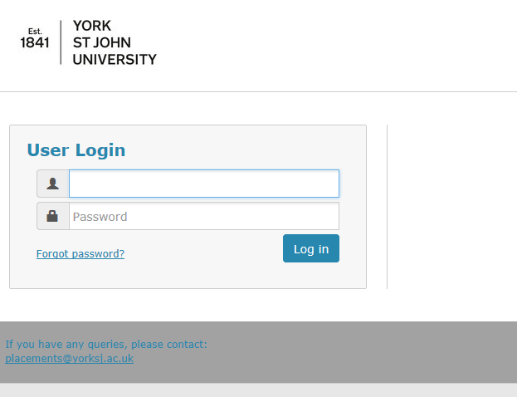
How to access the portal
You will receive an e-mail with the link to the portal and your login details. Enter these details on the Login Screen.
The link is https://placements.yorksj.ac.uk/pro/
www.yorksj.ac.uk

Slide 3
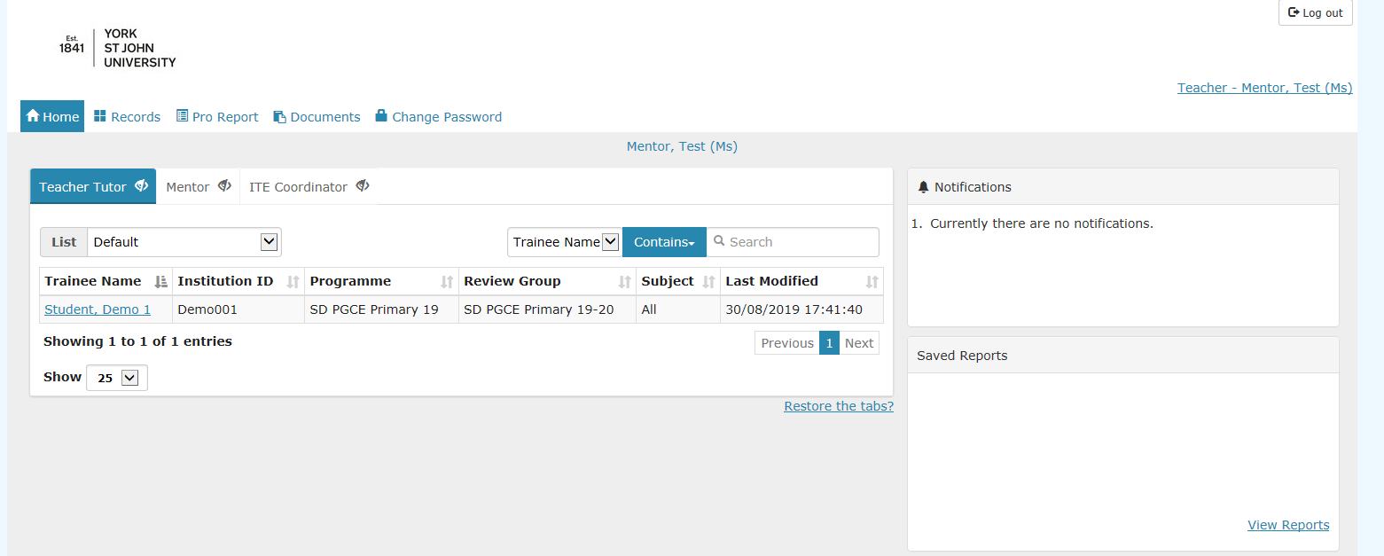
How to access the portal
When you have logged in you will be taken to the Home Page which shows the student teacher(s) you are mentoring. These will be listed under the ‘Teacher Tutor’ tab. You can hide the other tabs by clicking on the ‘eye’ icon if you wish.
If any of this information is incorrect please let us know at placements@yorksj.ac.uk
www.yorksj.ac.uk

Slide 4
How to change your password
Click on the ‘Change Password’ tab at the top of the page.
www.yorksj.ac.uk

Slide 5
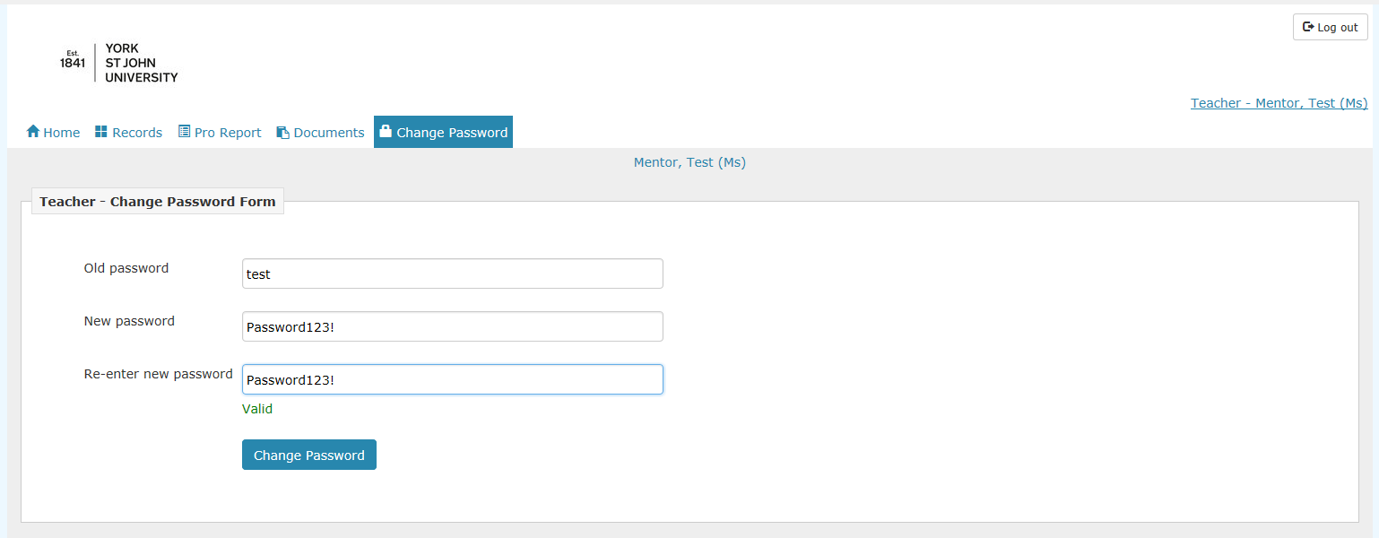
How to change your password
Type in your current password and then your new password twice.
Then click ‘Change Password’.
www.yorksj.ac.uk

Slide 6
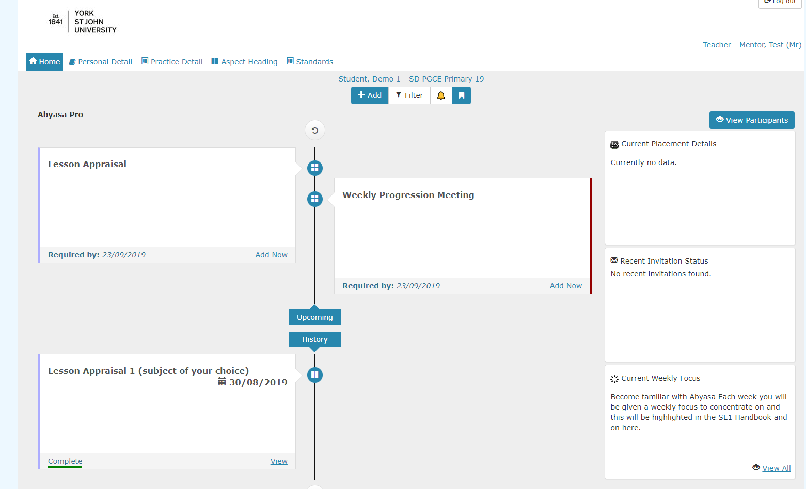
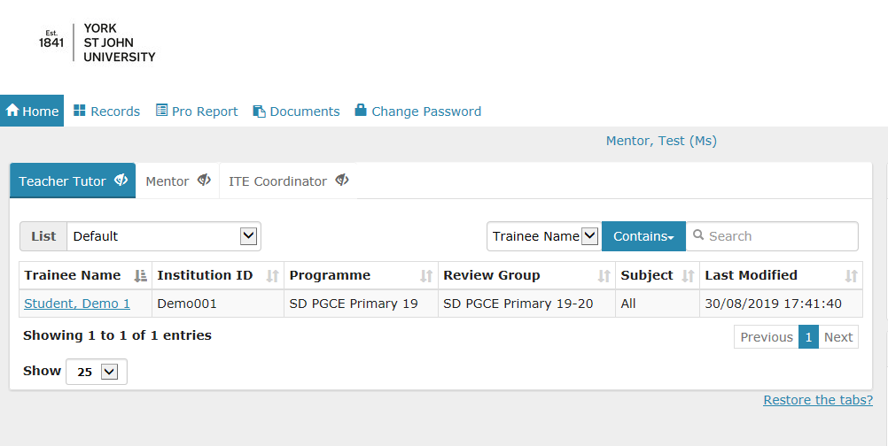
How to view and update reports
1. Start by clicking on the student you wish to add or edit reports for.
2. You will see the student’s timeline. If you scroll down you will see previous reports which have been submitted or where the deadline has passed. If you scroll up you will see upcoming reports.
www.yorksj.ac.uk

Slide 7
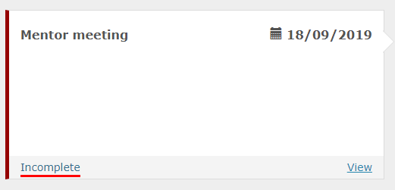
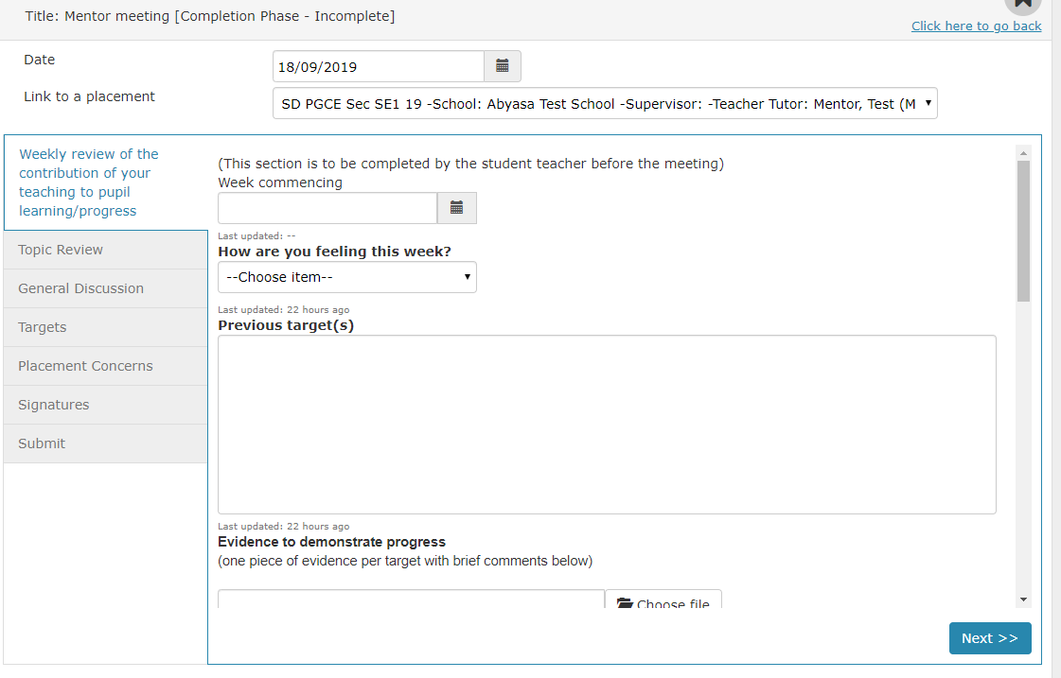
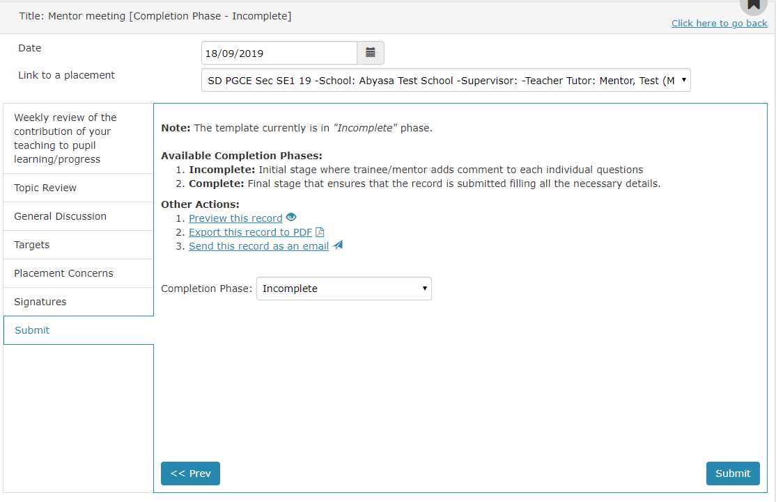
How to view and update reports
Remember, once you change the completion phase to ‘Complete’ it is no longer editable. Submit the report as ‘Incomplete’ if you still need to make amendments.
3. If you wish to edit a previous report select ‘View’ on that report.
4. The report will then appear and you can begin editing and follow the report to the end by clicking ‘Next’ and then ‘Submit’.
www.yorksj.ac.uk

Slide 8
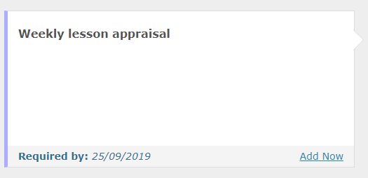
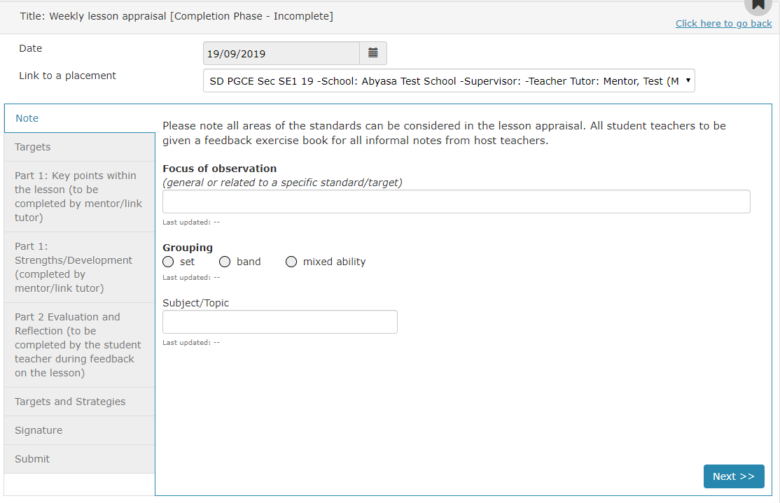
How to view and update reports
5. If you wish to submit an upcoming report click ‘Add Now’ on the report you want to add.
6. The date will be pre-populated. On the ‘Link to a placement’ drop down menu choose the correct placement which relates to this report. This will then take you to a screen where you can complete the report by filling in the boxes and clicking ‘Next’ and then ‘Submit’.
www.yorksj.ac.uk

Slide 9
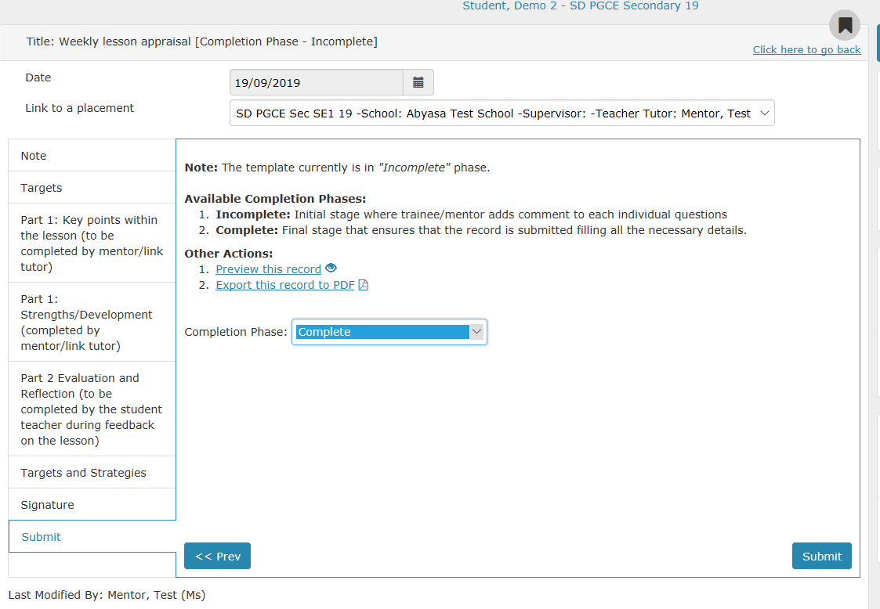
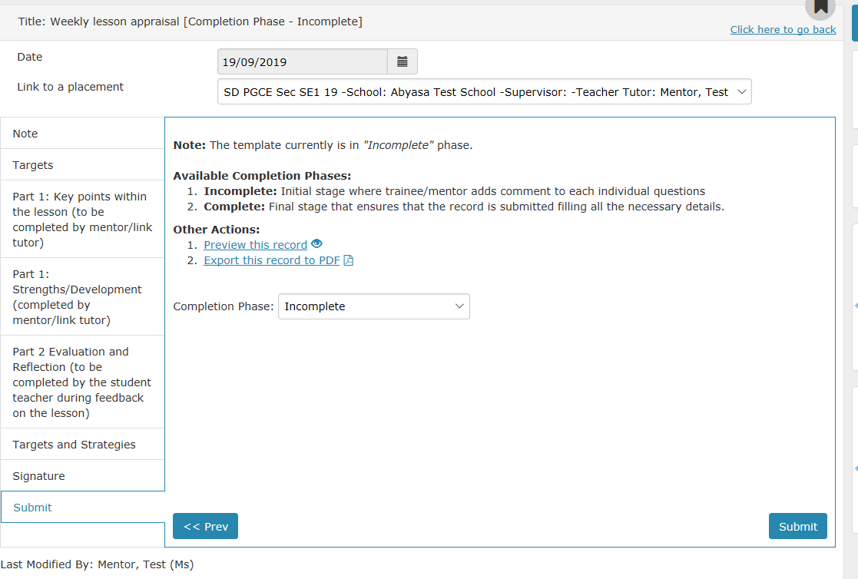
How to set a form to ‘Complete’
1. When you are happy that a form is completed and will need no further editing then you need to mark it as ‘Complete’ to make it final.
2. To do this you need to choose ‘Complete’ from the drop down box entitled ‘Completion Phase’ and then press ‘Submit’. Once this has been done all users will only be able to view the form and no further edits are possible.
www.yorksj.ac.uk

