Slide 1
Primary Link Tutors and Mentors
Development Meeting
22.01.20
WWW.YORKSJ.AC.UK

Slide 2
Agenda
12.00-1.00pm Lunch and networking
1.00pm University and School updates
1.45pm Unconscious Bias CPD
2.15pm ITT updates
2.45pm Information for new staff
www.yorksj.ac.uk

Slide 3
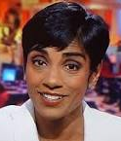
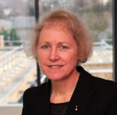
University updates
Simon Ganderton, Careers, Placements and Student Opportunities Manager
Reeta Chakrabarti, new Chancellor
Professor Karen Bryan, new Vice Chancellor

Slide 4
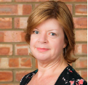
School updates
School of Education, Language and Psychology
Head of School, Rachel Wicaksono
Deputy Head of School, Caroline Elbra-Ramsay
Associate Head: Education, Keither Parker
www.yorksj.ac.uk

Slide 5
School updates
Exit appraisal replaced with Progress Review meeting during SE3
Abyasa: feedback and review
School priorities
www.yorksj.ac.uk

Slide 6
Authoritative - More Dominant
Confronting - Being challenging
Informing - Giving information and knowledge to gain a better understanding
Prescribing - Providing direct advice, offering opinions to directly influence
John Heron (1990) - ‘Helping the Client’

Slide 7
Facilitative - Less Dominant
Catalytic - Asking probing questions to encourage self learning
Supportive - Providing encouragement and confidence building, providing approval, confirmation and validation
Cathartic - Encourage the other person to express the emotions and release tensions, empathising with them
John Heron ‘Helping the Client’ (1990) London Sage

Slide 8
Key Priorities for the Primary Partnership
To increase:
achievement of G1 outcomes for male student teachers
student teacher confidence and competence for TS5 – Differentiation, including those who have special educational needs, are disadvantaged and the higher attaining pupils
student teacher confidence and competence for TS6 – Monitoring and Assessment (with particular reference to how assessment can be used to adapt teaching to maximise pupils’ progress)
www.yorksj.ac.uk

Slide 9
Key Priorities for the Primary Partnership
To ensure student teachers have the skills to plan for, teach and assess a broad and balanced curriculum and to increase consistency of opportunities for trainees to teach, assess and receive feedback on subjects other than English, mathematics and science
To develop student teacher understanding (and related strategies) of teacher and pupil mental health/resilience
To develop the quality (and perception of) student assessment and feedback
To action Phase 2 of the mentor and link tutor development strategy
www.yorksj.ac.uk

Slide 10
Developmental Priorities
To increase student teacher confidence and competence in teaching pupils with English as an additional language and pupils from all ethnic backgrounds
To increase student teacher confidence in relation to systematic, synthetic phonics (particularly those on the Upper route)
To develop and action a Subject Knowledge strategy given the removal of the Skills Test in 19-20
To respond to emerging national priorities and prepare for future developments, for example, the Early Career Framework
www.yorksj.ac.uk

Slide 11
Unconscious Bias
Are you biased?
www.yorksj.ac.uk

Slide 12
UG male student teachers meeting
SE3 data: Males at G1: 27%, females at G1: 56% (all primary programmes)
www.yorksj.ac.uk

Slide 13
Unconscious Bias training: Moodle
Details will be sent to you to access this training.
You will need your university email address and log in details.
www.yorksj.ac.uk

Slide 14
ITE Updates
Consultation out for new ITE Inspection framework (due to be implemented 2020-21): webinar link https://register.gotowebinar.com/recording/viewRecording/905731902977809410/1669702269470766604/c.elbraramsay@yorksj.ac.uk?registrantKey=5396235248050693900&type=ATTENDEEEMAILRECORDINGLINK
www.yorksj.ac.uk

Slide 19
ITE Updates

Slide 20
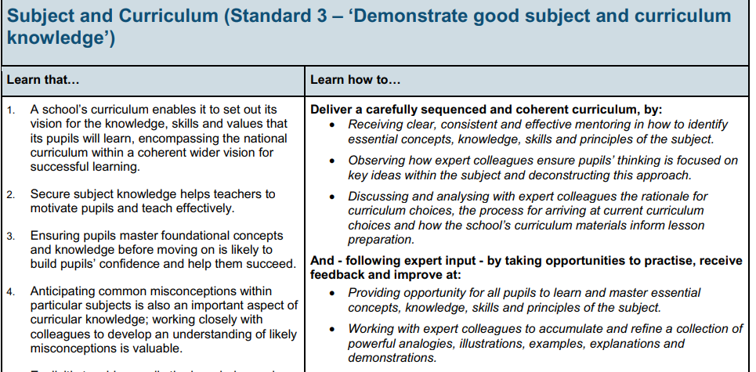
ITT Core Content Framework
Standard 1 High Expectations
Standard 2 How Pupils Learn
Standard 3 Subject & Curriculum
Standard 4 Classroom Practice
Standard 5 Adaptive Teaching
Standard 6 Assessment
Standard 7 Managing Behaviour
Standard 8 Professional Behaviours

Slide 21
Audit of current experience
www.yorksj.ac.uk

Slide 22
www.yorksj.ac.uk

