Slide 1
PGCE UC SE1
Mentor Briefing
November 2020
Jenny Carpenter, SE Director
WWW.YORKSJ.AC.UK

Slide 2
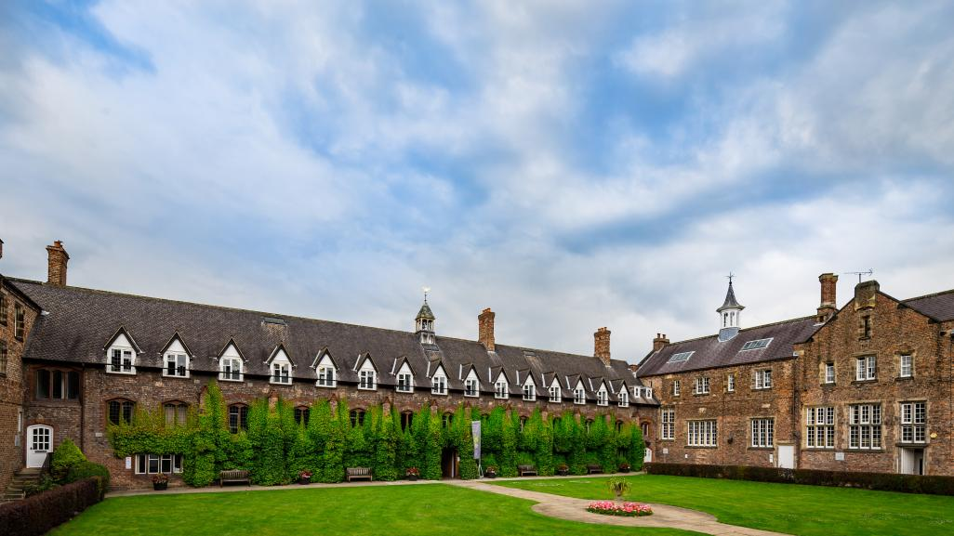
Thank you!
58 trainees
Range of background experiences with children
Positive engagement from the start of the programme
www.yorksj.ac.uk

Slide 3
The current situation
Expected disruption to the placement
ITT criteria has been revised by the DfE
YSJ has established a COVID-19 Coordination Centre
Student teachers will be expected to follow the school policy and guidance as well as be supported by the university
www.yorksj.ac.uk

Slide 4
Guidance for student teachers
If they develop symptoms:
self isolate for 10 days, immediately inform the school and university, arrange a test. We will keep in regular contact with the student. Return to school if test = negative or after the 10 days of self-isolation
If they have to take precautionary action:
self-isolate for 14 days, no need for a test unless they develop symptoms, immediately inform the school and university. Return to school after 14 days of self-isolation or if the person they have been in contact with returns a negative test
www.yorksj.ac.uk

Slide 5
Illness and absence
As with previous expectations, if a student teacher is ill, they are not expected to be working or studying
If they are not ill but self-isolating, they should keep in close communication with the school and discuss how they might be able to continue to support the class teacher
All absences due to illness to be recorded on Abyasa as usual
As previously, if a student teacher has longer term absence, a discussion will be needed by the Programme Lead and SE Director on a case by case basis about the implications
www.yorksj.ac.uk

Slide 6
Revised expectations for SE1
Student teachers will not be graded for lesson appraisals, interim report or final report
Outcome for SE1 will be pass (or fail)
Judgements will be made on engagement with the Teachers’ Standards
Please see pages 23-32 of the SE Handbook
It is important to remember that student teachers are not to be judged with the same expectations as qualified teachers
www.yorksj.ac.uk

Slide 7
TS5 | Student teachers should be aware of and demonstrate how to differentiate appropriately to enable pupils to be taught effectively. Student teachers understand how to challenge and motivate pupils to support groups where attainment is low. Student teachers should demonstrate awareness of the physical, social and intellectual development of pupils and begin to adapt teaching to support pupils’ education at different stages of development. This will include those with special educational needs, high attainers (including Gifted and Talented), English as an additional language, disabilities, disadvantaged and pupils eligible for the pupil premium (including Free School Meals). | Student teachers are unaware of differentiation strategies and do not use them in teaching. Student teachers have no understanding of how to challenge and motivate pupils to support groups where attainment is low. Student teachers are unaware of the range of factors that can inhibit pupils’ ability to learn. Student teachers do not have any understanding of the needs of all pupils including those with special educational needs, high ability (including Gifted and Talented), English as an additional language, disabilities, disadvantaged and pupils eligible for the pupil premium (including Free School Meals). | Speaking with teachers, support staff and SENCo to learn about pupils’ who may have any additional needs (not just cognitive). Observe a wide variety of teachers where possible and make notes on strategies and approaches. Use data from the school to identify pupils who may need a different approach. Attend partnership (School/alliance/YSJ) learning sessions and additional reading to learn more about how a variety of factors inhibit learning. Where possible, shadow a pupil (or selection of pupils who are at different stages of development) for a day to observe which strategies are used by experienced staff to support and engage them in learning. Try some of these strategies when teaching.
SE Handbook, page 26

Slide 8
Additional opportunities for students
Supporting the teacher: marking children’s work, preparing resources, remote teaching, planning for a group or individual child
Finding out about children: accessing children’s profiles, discussions with the teacher about children’s requirements
Finding out about the school: remote meetings with key staff, e.g., SENCo, reading school policies, looking through planning documents
University resources: online tasks, reading and research, planning topic work, developing and revising subject knowledge
www.yorksj.ac.uk

Slide 9
PGCE programme: first placement
Two stages: SE1 and SE2
SE1 (6 weeks)
An introduction to teaching with a focus on how children learn, pupil progression and designing learning for small and large groups
Teaching responsibility: 40% towards the latter part of the placement
3 formal appraisals
Formative report at the end of week 3 (interim report)
Final reports (mentor and student) at the end of the placement, targets for SE2
SE2 (6 weeks)
Developing skills, understanding and experience with 4 formal appraisals
Starting at 50% moving up to 70% responsibility
Interim report at the end of week 3
Final reports (mentor and student) at the end of the placement, targets for SE3
www.yorksj.ac.uk

Slide 10
SE1 essential features
Some whole class responsibility as soon as possible
Working with groups of children throughout the placement
Use of the teacher’s planning and devising own planning to support learning and teaching
Assessing children’s learning as an integral part of their practice
Professional development time to complete school-based tasks, observe other teachers and children if possible
Remote Link tutor initial meeting and observation of your feedback to student teacher
www.yorksj.ac.uk

Slide 11
Link tutor support: all remote for SE1
Link tutors are there to quality assure the mentoring process. There will be no face to face visits during SE1. All communication will take place through email and video calls.
An initial meeting during the first week of the placement to check:
you have completed mentor training during the last three years, the student is settling in, you are clear about the expectations of the placement and have all the necessary information
www.yorksj.ac.uk

Slide 12
Link tutor support: all remote for SE1
About half way through the placement, a remote observation of you and the student teacher’s discussion after a lesson appraisal. Agree the best platform to use with the link tutor.
the student teacher will need to send their lesson plan to the link tutor before the meeting
the link tutor will observe your discussion after the lesson appraisal, to take place as soon as possible after the lesson
www.yorksj.ac.uk

Slide 13
Link tutor support: all remote for SE1
the link tutor will then discuss with you their observations and you can agree any aspects of mentoring that you may feel you need additional support with
discussions will focus on the National Mentor Standards for ITT (https://assets.publishing.service.gov.uk/government/uploads/system/uploads/attachment_data/file/536891/Mentor_standards_report_Final.pdf)
www.yorksj.ac.uk

Slide 14
Planning requirements
Students need to present a lesson plan at least one day before they teach the activity so that the teacher can help them pitch learning at the right level.
They are not required to write weekly plans or medium term plans during SE1. They will write these for SE2. They may wish to ask the teacher and mentor for examples from the school’s planning.
www.yorksj.ac.uk

Slide 15
Planning requirements
Agree teaching/management responsibility for each week.
The teacher should provide the Early Learning Goal/ learning objective for the activity/task/lesson. If this comes from a weekly plan, it would be helpful if the student could have a copy of this too.
Students should decide on the pro forma to use. They can use the school planning, an example in the YSJ Planning and Assessment Guidance document or devise their own.
They should be experiencing whole class and small group activities throughout SE1.
www.yorksj.ac.uk

Slide 16
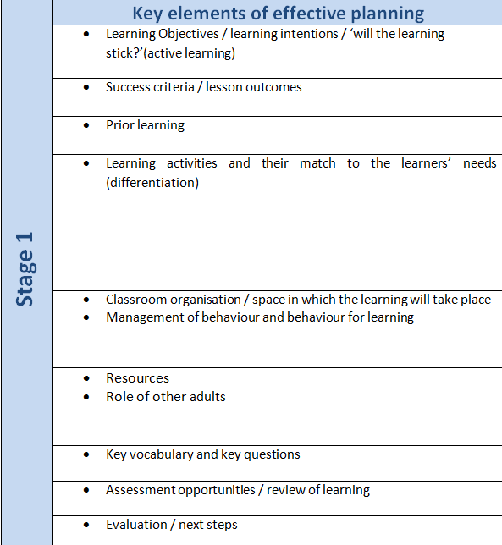
PAG page 35

Slide 17
Teaching requirements so far
earning theories).
Small group teaching can include
a focus activity (EYFS)
a group within a lesson led by the teacher (KS1 & 2)
the learning objective provided by the teacher but student plans the activity, including how they are assessing children
Teaching responsibility (40% of the week towards the mid-end point of the placement)
student introduces and leads the activity, having prepared resources and space beforehand, organising other adults as appropriate. They end the activity and then evaluate learning that has taken place, making records as appropriate. They discuss with the adults afterwards any implications for planning in the next lesson.t Masters level and they will present their fin

Slide 18
Assessment requirements so far
Student teachers need to be involved in the assessment of children from the start of SE1. Their planning starts with what the children already know, can do and understand. They will need access to:
children’s work
teacher assessment records
individual needs of children and EHCPs
at Masters level and they will present their fin

Slide 19
Assessment requirements so far
Student teachers will:
use prior achievement and teacher discussions to plan lessons
implement formative assessment strategies in their planning and teaching
evaluate learning and make records of children’s progress
contribute to the teacher’s records of children
observe and discuss with the teacher how this information feeds into tracking and target-setting
at Masters level and they will present their fin

Slide 20
Assessment requirements so far
Student teachers need:
guidance on assessment strategies from experienced teachers and practitioners
examples of how the school records children’s progress
suggestions about how they can plan for misconceptions and ask formative questions
TS6 is a national priority so it is essential that student teachers are involved in assessment straight away
TS 6at Masters level and they will present their fin

Slide 21
Assessing students: the Weekly Progression Meeting
Each week, a dialogic discussion with the mentor and student teacher takes place
Focus on the whole week, including the appraisal and wider responsibilities
Meeting notes to be recorded on the template on Abyasa Pro
Targets for the following week
Ongoing and developing strengths
Planning for CPD time
Student teacher shares evidence for 2-3 of the Teachers’ Standards
If the student teacher is self-isolating for 2 weeks, then they will upload a weekly reflection of their activities on Abyasa in place of this meeting
www.yorksj.ac.uk

Slide 22
Assessing students: appraisals
EYFS: 3 formal appraisals
This could be a ten minute activity, song or story and then up to 45 minutes observing them in the wider management role of the setting
Key Stages 1 and 2: 3 formal appraisals of a whole class lesson
This could be a science experiment, a themed or topic lesson where they are managing the whole class.
All appraisals should last approximately 1 hour
Appraisals are not graded
www.yorksj.ac.uk

Slide 23
Interim report
At the end of week 3, the mentor will submit an interim report on Abyasa on the engagement with the Teachers’ Standards. Use the grid in the SE Handbook to inform your comments
Strengths and targets the student is working on. This should be shared with the student as part of the weekly progression meeting
Any concerns about the student at this stage must be discussed with the link tutor
www.yorksj.ac.uk

Slide 24
Tracking student progress
Use Abyasa Pro to record appraisals, weekly progression meetings, reports and targets
Abyasa Pro accessed at: https://placements.yorksj.ac.uk/pro/
There is a short presentation to show you how to use Abyasa here:
https://www.yorksj.ac.uk/working-with-the-community/placement-providers/initial-teacher-education/#using-abyasa-pro
www.yorksj.ac.uk

Slide 25
Documentation: students
Students have 2 files:
Teaching File
Planning, Archive and Context File
SE Handbook
Planning & Assessment Guidance handbook
Part of the mentor role is to ensure the student teacher is organised with their paperwork
www.yorksj.ac.uk

Slide 26
End of SE1 reports
Student and mentor complete a summative report each
Comments on the Teachers’ Standards including Part 2 PPC
Targets to take forward to SE2
www.yorksj.ac.uk

Slide 27
By the end of SE1, students should have…
trialled and refined lesson planning
trialled assessment strategies, both formative and summative
had 3 appraisals
had an Interim Report and summative reports on Abyasa
decided on teaching responsibility for SE2. This includes subjects of the curriculum they will be responsible for planning/or areas of the EYFS classroom they will oversee
www.yorksj.ac.uk

Slide 28
By the end of SE1…
The student should be aware of their strengths in relation to the Teachers’ Standards
They should have discussed (with the mentor, teacher and academic tutor) how they are going to work towards their targets and the strategies they will employ to make progress
At this stage of their teacher education, they will have had limited opportunities
The programme is structured to enable them to build on their skills, knowledge and understanding gradually, with important opportunities to reflect accurately on these
www.yorksj.ac.uk

Slide 29
What to do if…
You haven’t got a log in for Abyasa:
check the school email and your email, if nothing then email the Placements Team: placements@yorksj.ac.uk
You are unsure of the teaching requirements:
look through the SE Handbook
The student teacher is unprepared:
have an early meeting to discuss any issues, then contact your link tutor if unresolved
You haven’t had training and you’re going to be the mentor:
an external mentor may need to be allocated so contact the Placements Team. Or you may have another member of staff who has completed the mentor training.
You have further questions:
Ask the student teacher, check the SE Handbook, or email the link tutor

Slide 30
Final points…and thanks again!
Keep in touch with the link tutor
Guidance about SE2 will be available in a briefing early January
Weekly email from me with updates, reminders and information throughout the placement
www.yorksj.ac.uk

Slide 31
www.yorksj.ac.uk

